Slide 1
Generative Adversarial Networks (GAN)

Slide 2
Overview of GAN Structure
A generative adversarial network (GAN) has two parts:
Generator: learns to generate plausible data. The generated instances become negative training examples for the discriminator.
Discriminator: learns to distinguish the generator's fake data from real data. The discriminator penalizes the generator for producing implausible results.

Slide 3



Overview of GAN Structure
During training the generator produces fake data, and the discriminator quickly learns to tell that it's fake:
As training progresses, the generator gets closer to producing output that can fool the discriminator:
Finally, if generator training goes well, the discriminator gets worse at telling the difference between real and fake. It starts to classify fake data as real, and its accuracy decreases.

Slide 4
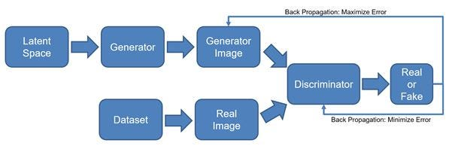
Overview of GAN Structure

Slide 5
Overview of GAN Structure
Both the generator and the discriminator are neural networks.
The generator output is connected directly to the discriminator input.
Through backpropagation, the discriminator's classification provides a signal that the generator uses to update its weights.
Architecture Design Considerations:
Layer Types (Convolutional, Fully Connected)
Activation Functions
Loss Functions
Optimizers

Slide 6
How does a GAN work?
The steps involved in how a GAN works:
1. Initialization: Two neural networks are created: a Generator (G) and a Discriminator (D).
G is tasked with creating new data, like images or text, that closely resembles real data.
D acts as a critic, trying to distinguish between real data (from a training dataset) and the data generated by G.
2. Generator’s First Move: G takes a random noise vector as input. This noise vector contains random values and acts as the starting point for G’s creation process. Using its internal layers and learned patterns, G transforms the noise vector into a new data sample, like a generated image.

Slide 7
How does a GAN work?
3.Discriminator’s Turn:D receives two kinds of inputs:
Real data samples from the training dataset.
The data samples generated by G in the previous step. D’s job is to analyze each input and determine whether it’s real data or something G cooked up. It outputs a probability score between 0 and 1. A score of 1 indicates the data is likely real, and 0 suggests it’s fake.
The Learning Process: Now, the adversarial part comes in:
If D correctly identifies real data as real (score close to 1) and generated data as fake (score close to 0), both G and D are rewarded to a small degree. This is because they’re both doing their jobs well.
However, the key is to continuously improve. If D consistently identifies everything correctly, it won’t learn much. So, the goal is for G to eventually trick D.

Slide 8
How does a GAN work?
Generator’s Improvement:
When D mistakenly labels G’s creation as real (score close to 1), it’s a sign that G is on the right track. In this case, G receives a significant positive update, while D receives a penalty for being fooled.
This feedback helps G improve its generation process to create more realistic data.
Discriminator’s Adaptation:
Conversely, if D correctly identifies G’s fake data (score close to 0), but G receives no reward, D is further strengthened in its discrimination abilities.
This ongoing duel between G and D refines both networks over time.
As training progresses, G gets better at generating realistic data, making it harder for D to tell the difference. Ideally, G becomes so adept that D can’t reliably distinguish real from fake data. At this point, G is considered well-trained and can be used to generate new, realistic data samples.

